Slide 1
Measure it to Manage it: Key Performance Indicators

Slide 2
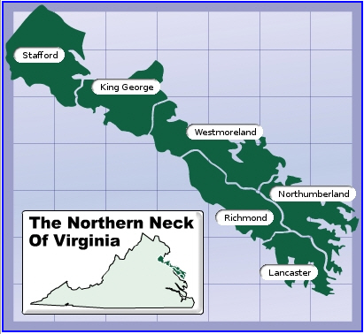
Northern Neck Electric Cooperative
Warsaw, VA
18,500 meters
6 Counties
1,900 miles of line
20 Substations
30% Seasonal

Slide 3
NNEC IT Mission Statement
To the Coop - Provide Cooperative employees the tools and technology to help them perform their job more efficiently and safely To the Members - Provide members with tools to help them reduce energy consumption, save money and preserve the environment

Slide 4
"If you can not measure it, you can not improve it.“ ~~ Lord Kelvin

Slide 5
What is a “KPI?”
A Performance Indicator or Key Performance Indicator (KPI) is an industry jargon term for a type of Measure of Performance.^{[1]} KPIs are commonly used by an organization to evaluate its success or the success of a particular activity in which it is engaged. Sometimes success is defined in terms of making progress toward strategic goals,^{[2]} but often, success is simply the repeated achievement of some level of operational goal (zero defects, 10/10 customer satisfaction etc.). Accordingly, choosing the right KPIs is reliant upon having a good understanding of what is important to the organization. 'What is important' often depends on the department measuring the performance - the KPIs useful to a Finance Team will be quite different to the KPIs assigned to the sales force, for example. Because of the need to develop a good understanding of what is important, performance indicator selection is often closely associated with the use of various techniques to assess the present state of the business, and its key activities. These assessments often lead to the identification of potential improvements; and as a consequence, performance indicators are routinely associated with 'performance improvement' initiatives. A very common method for choosing KPIs is to apply a management framework such as the Balanced scorecard.

Slide 6
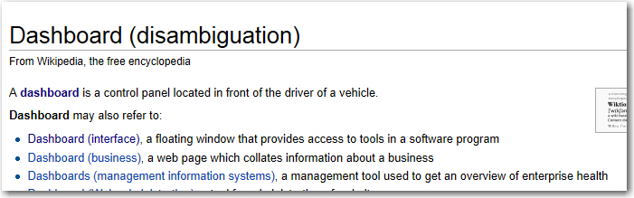
What is a “Dashboard?”

Slide 7
Displaying KPI’s
Board Reports
eMails
Texts
Display Monitors
Daffron iXp Dashboard
Internal Intranet Pages
iDashboard

Slide 8
KPI’s – Something For Everyone
Accounting/Financial
Engineering
Operations
Safety
IT
Customer Service
The Board
Members
Public Relations

Slide 9
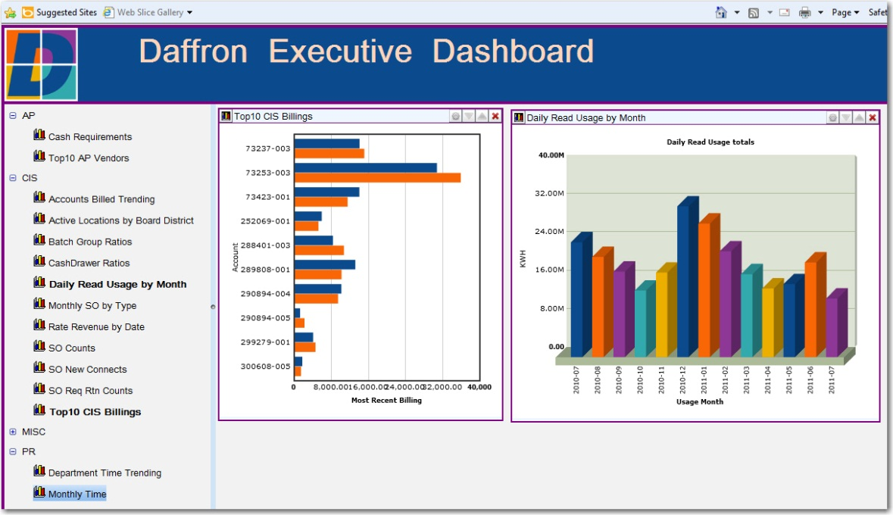
Accounting & Finance
Revenue By Month
Payroll – Regular & Overtime
Cash Requirements
Top AP Vendors
Department Time Trending
Monthly Time
# of Members
Tier

Slide 10
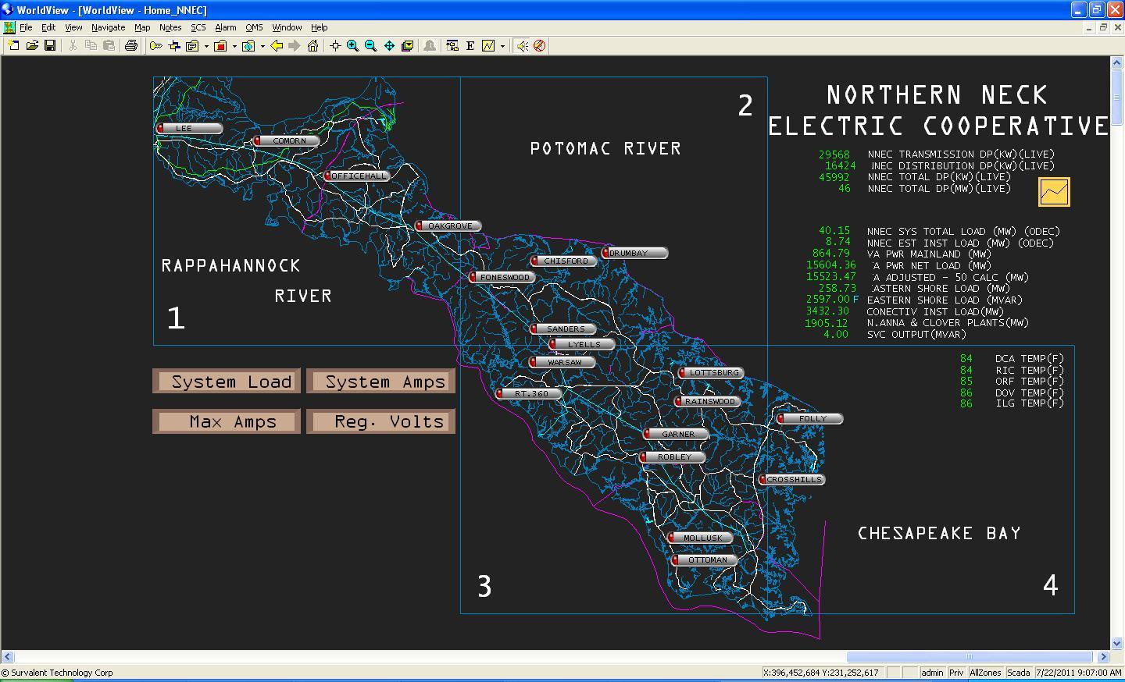
Engineering
Work Orders
Staking Jobs
New Services
Loading
Transformer
Substation

Slide 11
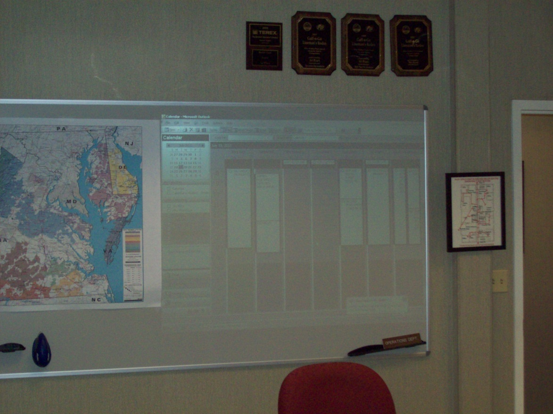
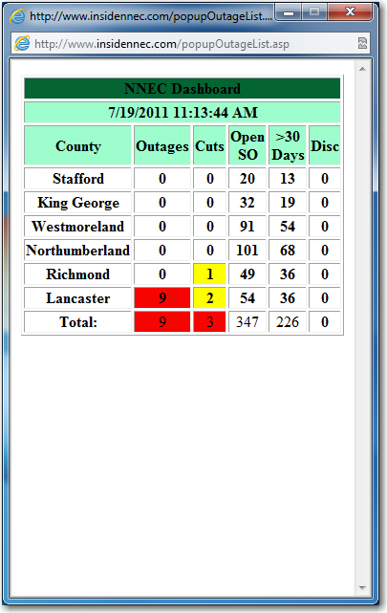
Operations
Outages
Outage Statistics

Slide 12
Safety
Accident Free miles
Accident Free man hours

Slide 13
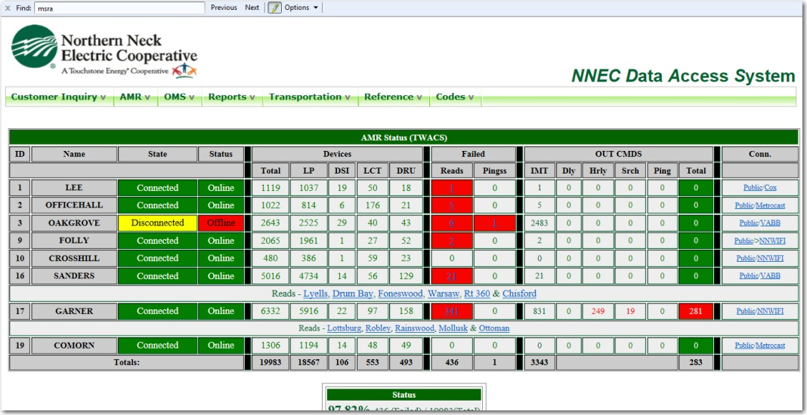
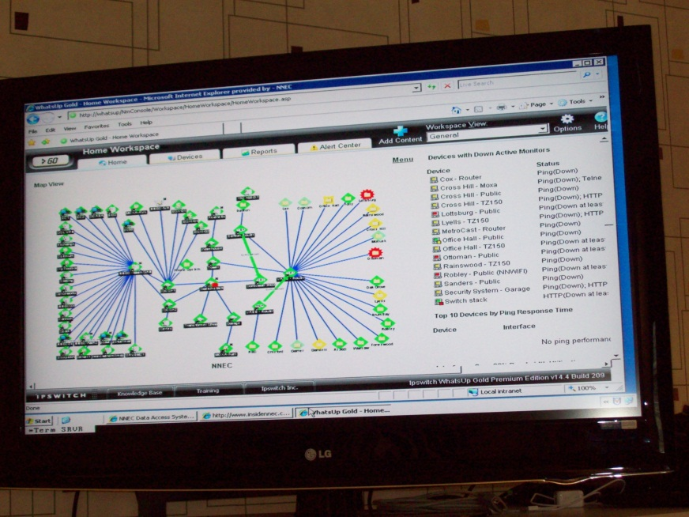
IT
AMR Status
Device Status
Virtualization Status
Communications Status
Trouble Tickets

Slide 14
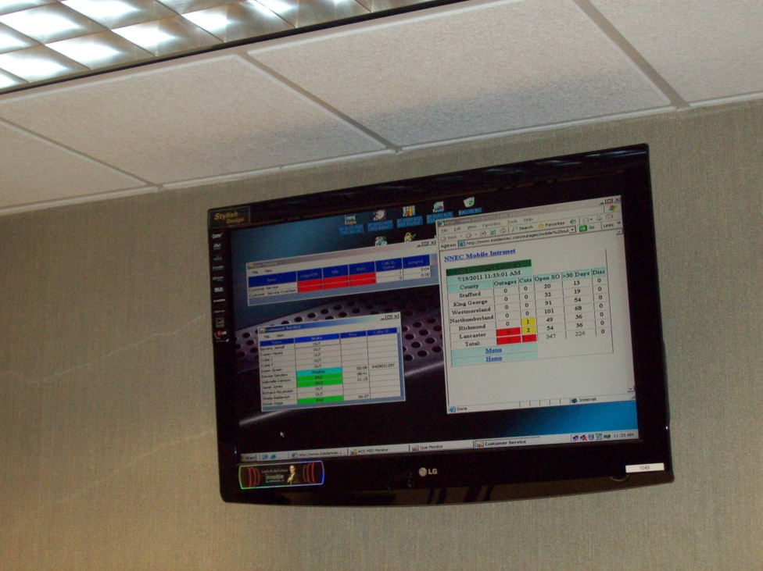
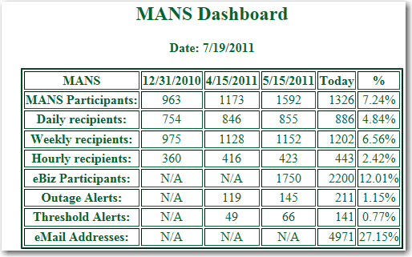
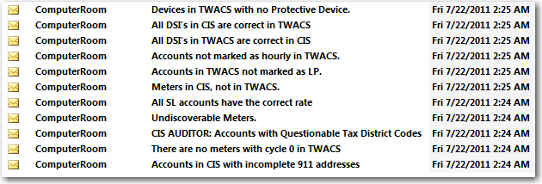
Customer Service
Calls
Outages
Service Order Counts
MANS Participants
E-Biz Participants
eMail Addresses
Disconnects
Data Integrity

Slide 15
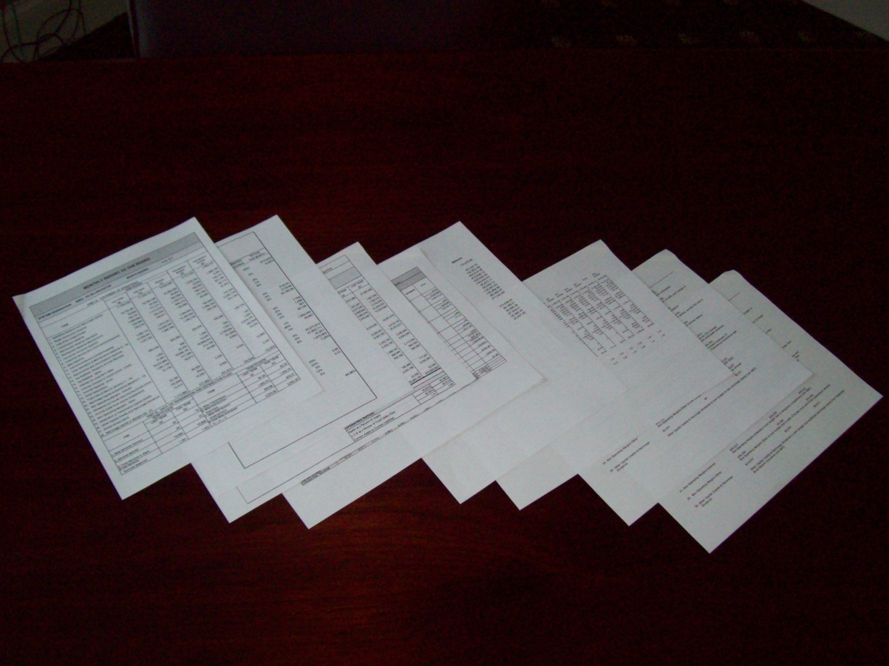
The Board
Sales
Purchased Power
Expenses
Tier
OTier
New Services
Line Loss
Budget
Margins
Members
Miles of line
Average Usages
Equity

Slide 16
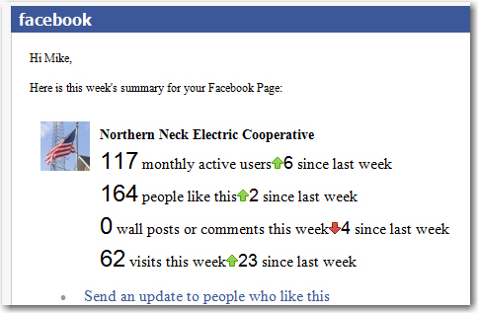
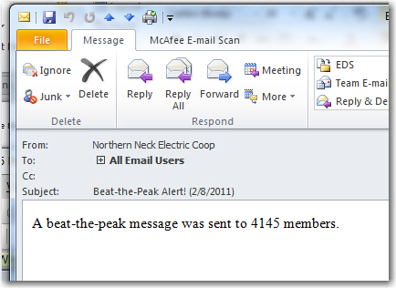
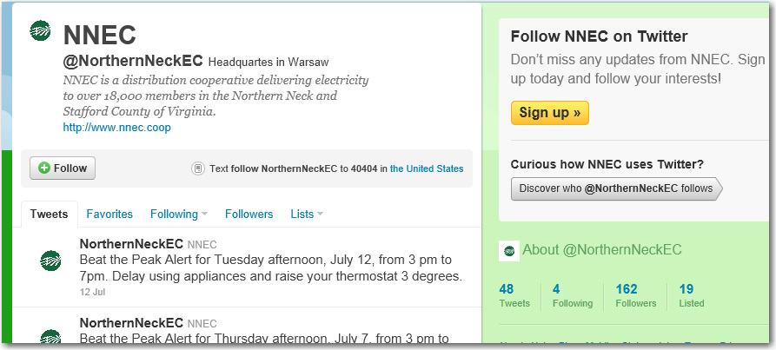
Public Relations
Social Media Followers
Newsletter Subscribers
eBiz Participants

Slide 17
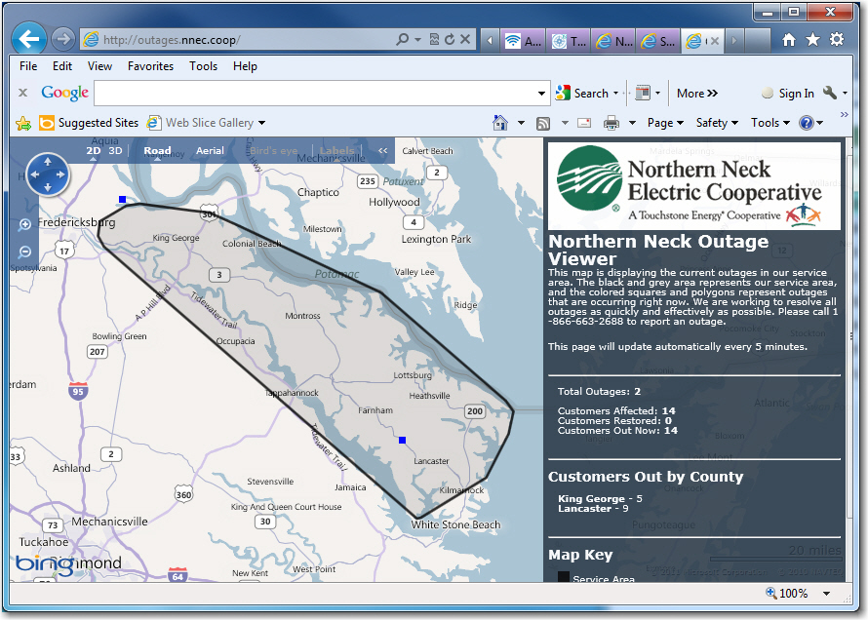
Members
Rates
Capital Credit Refunds
Outages

Slide 18
Resources
iDashboard.com
SmartKPI’s.com
Kpilibrary.com
Wikipedia.org

Slide 19
Thank You!
Michael Hyde
mhyde@nnec.coop

